Slide 1



VIDHAYIN KADHAI The beginning of life…
CONNECTATHON

Slide 2

CONNECTATHON
To those that work in acres, not in Hours
We thank you.

Slide 3
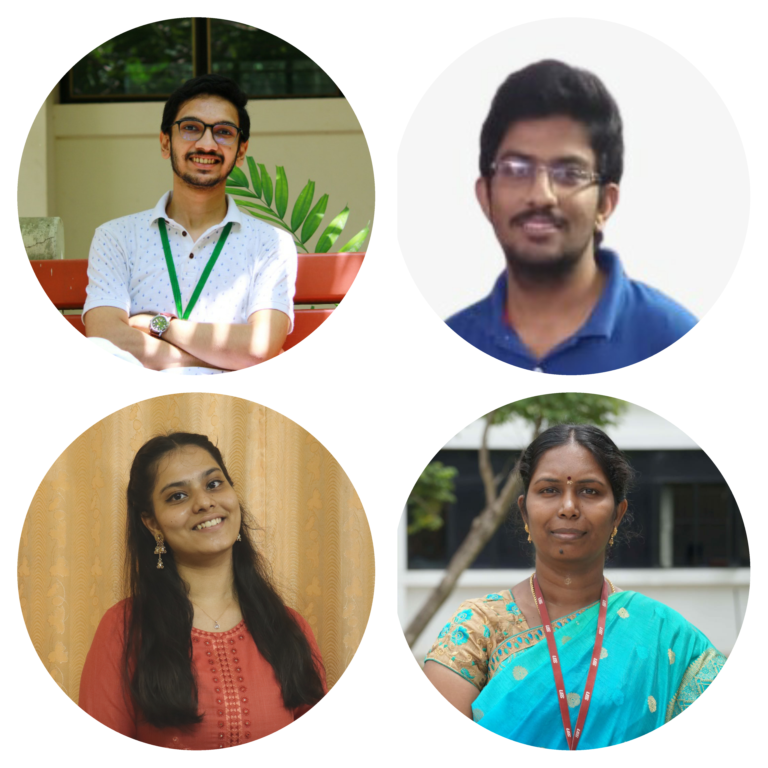
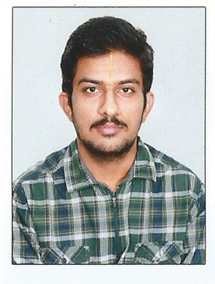
MEET THE TEAM
CONNECTaTHON TEAM 5 : SRH AGRITECH
SSN COLLEGE OF ENGINEERING, KALAVAKKAM
Sai Krishna S Undergraduate, EEE
Backend, ML
Rengarajan S Undergraduate, EEE
Backend, ML
V. Harini Undergraduate, EEE
Frontend
S Rajalakshmi
Mentor
Assistant Professor, CSE
Expertise in ML and Data mining

Slide 4
PROBLEM STATEMENT
CONNECTATHON
Improper selection of crops and the lack of organic practices
Irrational use of agricultural land has led to depletion and exhaustion of soil
Lack of Precision Farming Practices are hurting the crop yields.
Out of 61 Lakh acres of agricultural land only 31687 acres of land has been registered under organic certification by 4768 farmers in Tamil Nadu which accounts for meager 1 percent of total land.
* https://www.tnocd.net/

Slide 5
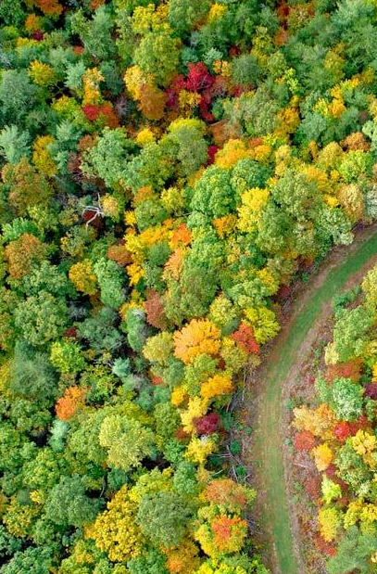
Existing Solutions
CONNECTATHON
Crop suggestion
The existing algorithms recommend a single crop based on the soil conditions as their only constraints.
Supplying Nutrients
Only about 1 percent of farmers in Tamil Nadu currently employ organic farming and bio-fertilizers.

Slide 6

How is Our soultion Different?
CONNECTATHON
Crop Suggestion
Considers soil conditions, demand of the crop and the financial constraints of the farmer.
Previous history of crops sown and the profits earned by the farmer is considered.
Supplying Nutrients
Suggests Organic farming methods and manures.
Thus, farmers in Tamil Nadu can start incorporating organic methods of farming, increasing the yield and health of the crops

Slide 7
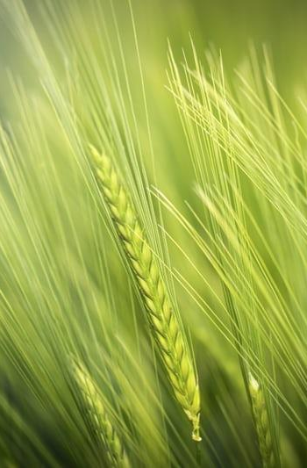
UNIQUE VALUE PROPOSITION
CONNECTATHON
Crop suggestions based on demand of the crop
Previous history of crops sown, profits earned and
the financial state of the farmer
03
01
02
Health of the Land is considered an important factor

Slide 8
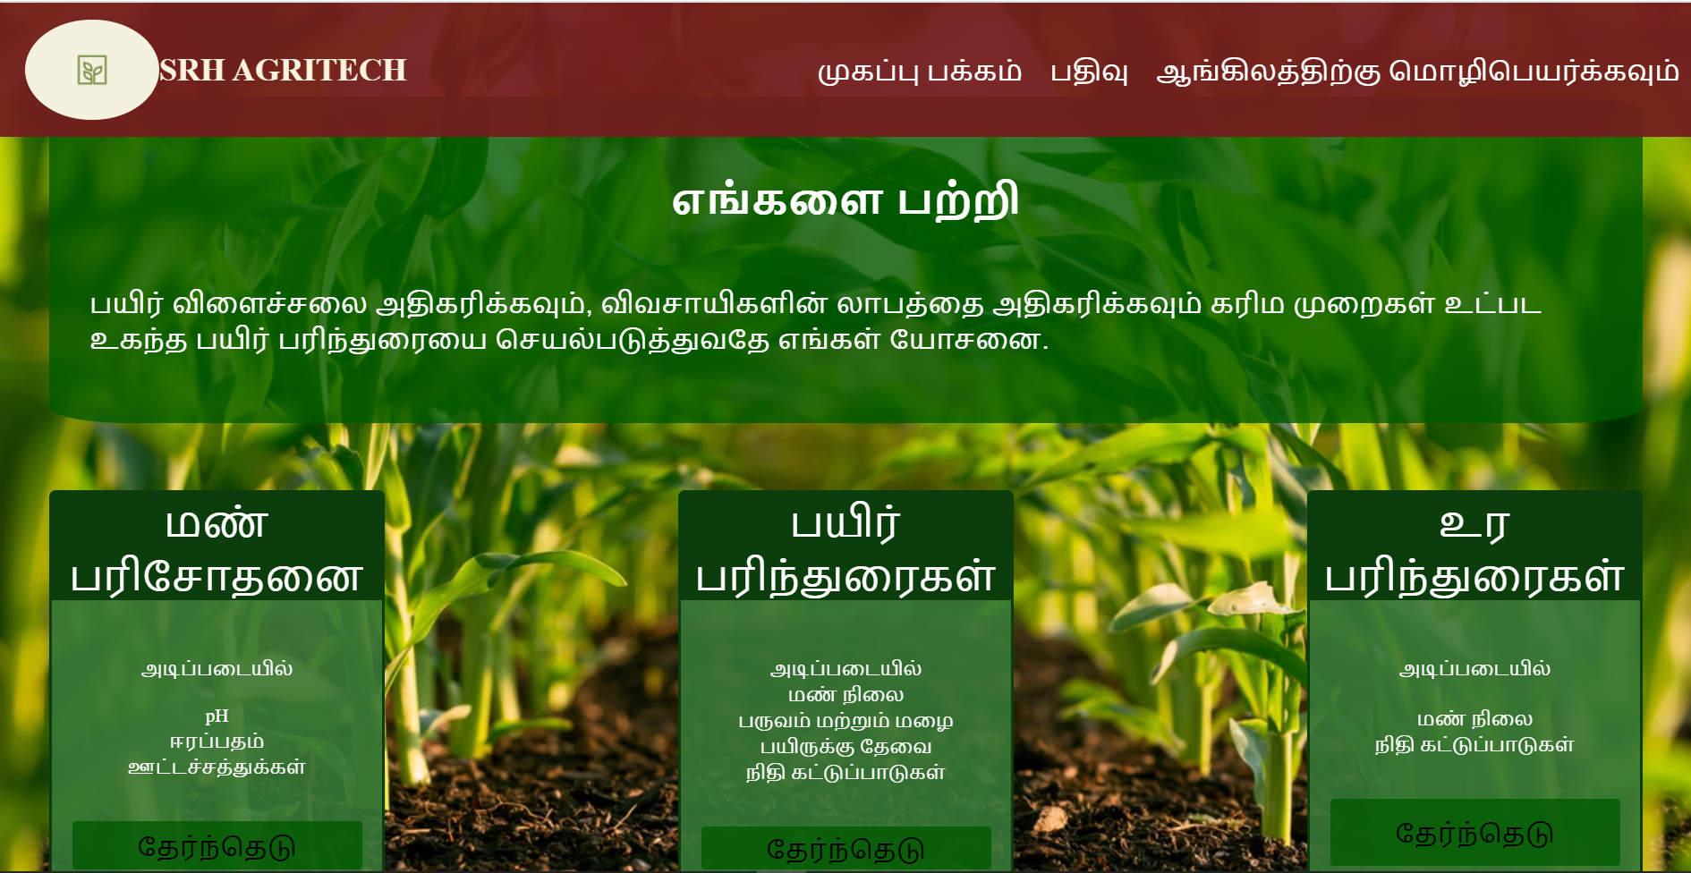
CONNECTATHON
Website
An easy to use website containing details of the services provided by us.
The website is also available in Tamil!
Any farmer can easily register in the website.

Slide 9

CONNECTATHON
We are planning to make a Mobile app (Future Scope)
The mobile app would make it easier for the farmers to get the necessary information from anywhere.
With the help of a mobile app the farmer the check the health of the crop by taking a picture of it.

Slide 10
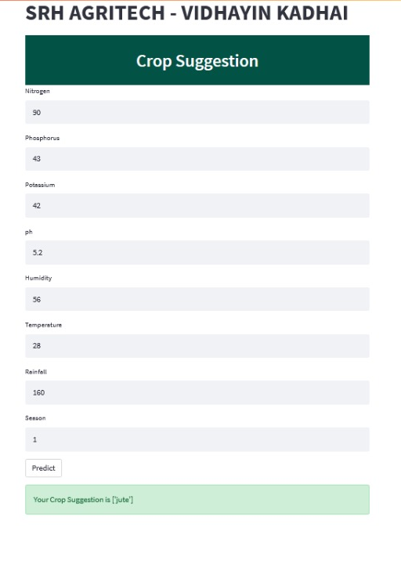
CONNECTATHON
Model of Crop Suggester
The model is built using Machine Learning Algorithms
In this model the inputs are given manually
The model considers NPK values, pH, Temperature, Humidity, Rainfall and Season

Slide 11
MARKET SIZE
CONNECTATHON
Our Products will extend to the farmers and agricultural solutions related companies.
Farmers in Tamil Nadu: 0.794 crores as of 2015-16
20+ big agricultural related companies in Tamil Nadu.
COMPETITORS
Agri solution companies like Fasal, RMSI Cropalytics and other startups evolving on agritech.
* https://www.thehindubusinessline.com/economy/agri-business/how-many-farmers-are-there-in-india-government-has-no-clue/article30614882.ece

Slide 12
FINANCIALS
CONNECTATHON
Year |  | 1 | 2 | 3 |  |  | 1 | 2 | 3
Revenue |  |  |  |  |  | QUANTITATIVE DATA
Software sale |  | 220,000 | 440,000 | 780,000 |  | Software sale | 2 | 4 | 6
Increased software capacity |  | 0 | 40000 | 60000 |  | Increased software capacity | 0 | 3 | 4
Hardware sale |  | 20,000 | 30,000 | 52,000 |  | Hardware sale | 2 | 2 | 3
Hardware support* |  | 3000 | 4000 | 6000 |  | Hardware support* | 2 | 2 | 3
Hosting ads in website |  | 0 | 0 | 0 |  | Hosting ads in website | 0 | 0 | 0
Sale of data to companies* |  | 50,000 | 75,000 | 90,000 |  | Sale of data to companies* | 2 | 4 | 5
Total Revenue |  | 293,000 | 589,000 | 988,000
COGS(Cost of Goods sold)
Software sale |  | 200,000 | 400,000 | 600,000
Increased software capacity |  | 0 | 30,000 | 45,000
Hardware sale |  | 13,500 | 27,000 | 48,000
Hardware support* |  | 2500 | 3,200 | 4500
Hosting ads in website |  | 0 | 0 | 0 |  | * Depends on time
Sale of data to companies* |  | 0 | 0 | 0
Total COGS |  | 216,000 | 460,200 | 697,500
GROSS MARGINS |  | 77,000 | 128,800 | 290,500

Slide 13
Business Model Canvas
CONNECTATHON
Key Partners
Government agencies
Agro Fertilizer Companies
Google ad services
Cloud based services (AWS, Azure)
Key Activities
Crop predictions and consulting
Crop health monitoring
Organic Manure suggestions
Value Propositions
Crop suggestions based on demand of the crop
Previous history of crops sown, profits earned and
the financial state of the farmer
Health of the Land is considered an important factor
Customer Relationships
Dedicated personal assitance
Automated services
Contract with farming based companies
Customer Segments
Practicing Farmers
Companies assiting farmers
Key Resources
Soil monitoring devices and sensors
Website and app
Channels
Website / App available in regional language
SMS (Future scope)
Voice messages (Future scope)
Cost Structure
One time Cost: Rs 1,00,000
Fixed Cost : Rs 10,000/month
Variable Cost : Rs 1,000/month
Total Costs= Rs 2,32,000 Approx
Revenue Streams
Website, app
Companies that by our software
Agro Fertilizer companies

Slide 14
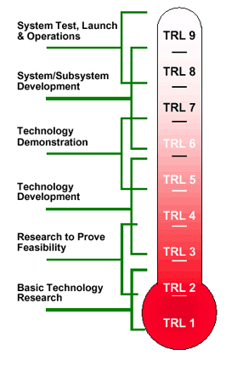
CONNECTATHON
TECHNOLOGY READINESS LEVEL
TRL 6
We have developed the main backend and frontend of the technology
We are currently working on improving algorithm and adding more features to the software

Slide 15
Roadmap
CONNECTATHON
Building of the Technology
Getting the data from the customers
Expanding the primary network
1
3
5
2
4
6
Reaching the target customers
Storing the data in repositories
Expanding the secondary network

Slide 16
CONNECTATHON
Ease and Feasibility of Our Product:
Easy to use website interface available in regional language.
Suggests organic farming and health monitoring methods.
Considers their financial constraints and previous profits earned.
FUTURE SCOPE:
A mobile app can be developed for the same.
The suggestions can be sent as an sms or a voice message(IVRS) in their regional language.

Slide 17
Thank you
CONNECTATHON

